Slide 1
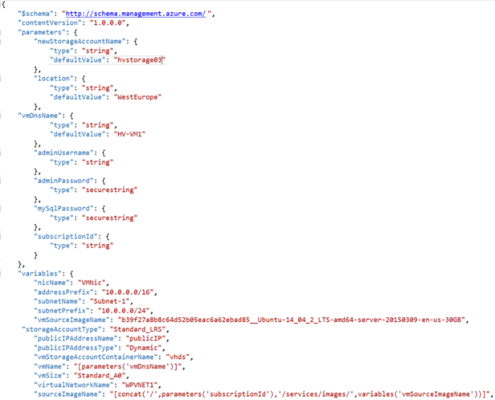



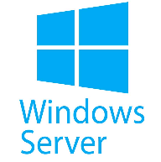

Infrastructure as Code
Automation with ARM Templates

Slide 2
Agenda
Infrastructure as Code overview
Iterative hands on challenges
Breaks for food and stretching
Sharing & recaps throughout the day
Notes:
Welcome to homeroom… where we take attendance and make all the announcements, say the pledge of allegiance, etc.

Slide 3
Challenge #0 Step 1: Get your machines ready!
Install Windows Subsystem for Linux (Bash Shell)
Install the Azure CLI (V2)
Install Visual Studio Code
Install ARM Template plugins for VS Code
ARM Tools
ARM Snippets
Notes:
If you have a Mac… great! You’re already a step ahead.
If not, get your Windows box loaded up with all the tools that work well in the OSS world!

Slide 4
Infrastructure as Code

Slide 5

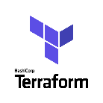






Infrastructure as Code Three major parts
Deploying infrastructure
All of the stuff outside the VM
Vnets, VMs, load balancers, storage, etc
Configuration Management
Configuring all of the stuff inside the VM
Security, services, software, etc.
Orchestration
Stringing it all together with automation
ARM Templates
PowerShell
DSC
Notes:
If you have a Mac… great! You’re already a step ahead.
If not, get your Windows box loaded up with all the tools that work well in the OSS world!

Slide 6
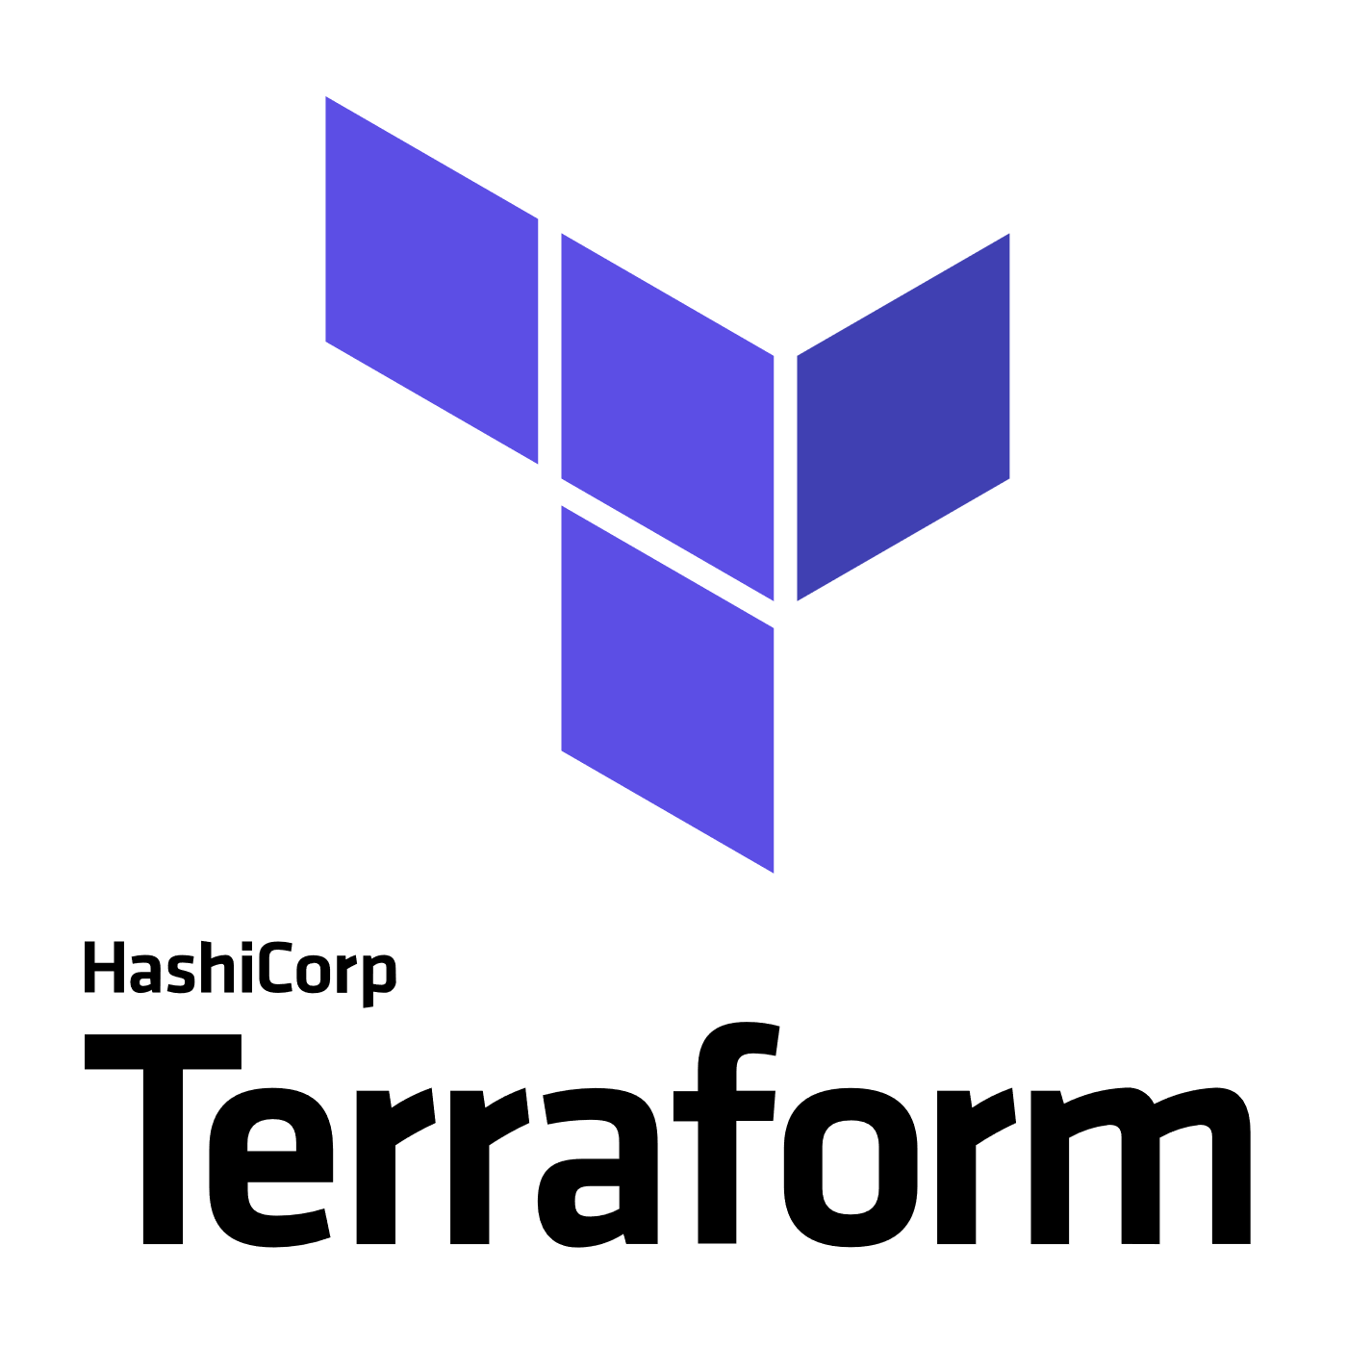
3rd Party
Infrastructure
Deployment (Orchestration)
Terraform
A popular Infrastructure as Code tool as it has support for Azure, AWS, GCP, OpenStack and bare metal, providing customers with a single provisioning language across providers
Provider modules allow for provider specific features, so no “lowest common denominator” flaws of similar multi-cloud tools
“Planning” provides users a preview of changes prior to execution (Terraform plan)
https://docs.microsoft.com/en-us/azure/virtual-machines/terraform-create-complete-vm
https://www.terraform.io/docs/providers/azurerm/
Packer
An automated image builder capable of building containers, but primarily used for automating VM image builds
A great tool when combined with DevOps pipelines that are targeting deployment to services like Azure VMs, VM Scale Sets or Batch
Used internally to deliver VM images for HD Insights and Azure Container Service
https://aka.ms/azpacker

Slide 7


3rd Party
Configuration Management & Orchestration
Ansible
Configuration Management & Orchestration
Agentless architecture over SSH / WinRM
Benefit of more easily integrating existing environments
YAML based “Playbooks” to define automation tasks as code
Project now run by Red Hat
https://docs.microsoft.com/en-us/azure/virtual-machines/linux/ansible-create-complete-vm
https://docs.ansible.com/ansible/guide_azure.html
Chef Server
Configuration Management
Integrates in to Chef’s Automate offering, available in Azure Marketplace
YAML/JSON based “Cookbooks” to define automation tasks as code
Agent based, requires an agent installed on managed servers.
https://www.chef.io/implementations/azure/
Notes:
Compare/Contrast: (Orchestration vs Configuration Management tools) Configuration management tools such as Chef and Ansible,typically default to a mutable infrastructure paradigm. For example, if you tell Chef to install a new version of OpenSSL, it’ll run the update on your existing servers and the changes will happen in-place. Over time, as you apply more and more updates, each server builds up a unique history of changes. This often can lead to configuration drift, where each server becomes slightly different than all the others, leading to subtle configuration bugs that are difficult to diagnose/reproduce. If you’re using an orchestration tool such as Terraform to deploy machine images created by Docker or Packer, then every “change” is actually a deployment of a new server, you would create a new image using Packer or Docker with the new version of OpenSSL already installed, deploy that image across a set of totally new servers, and then de-provision the old servers. This approach reduces the likelihood of configuration drift bugs. Of course, it’s possible to force configuration management tools to do immutable deployments too, but it’s not the idiomatic approach for those tools, whereas it’s a natural way to use orchestration tools.
Chef and Ansible encourage a procedural style where you write code that specifies, step-by-step, how to to achieve some desired end state. Terraform, CloudFormation, SaltStack, and Puppet all encourage a more declarative style where you write code that specifies your desired end state

Slide 8


OrchestrationTools
Jenkins
Most popular Continuous Integration & Continuous Delivery Tool
Especially popular with Java shops
An extensive community and catalog of plugins available
Azure Plugins available to use on-demand VMs for Build & Test
Jenkins Solution Template: https://aka.ms/jenkins-on-azure
Microsoft published. A Jenkins build secured for Azure and pre-configured with Azure plugins and tools
Jenkins Hub is a great starting point for customers: http://aka.ms/azjenkinshub
Spinnaker
Continuous Deployment Tool
Originally open sourced by NetFlix
Provides the ability to manage continuous deployment pipelines with multiple deployment strategies and the ability to roll back easily to previous versions
Spinnaker Code Labs for Azure:
CD to Azure VM ScaleSet
CD to K8s on Azure

Slide 9

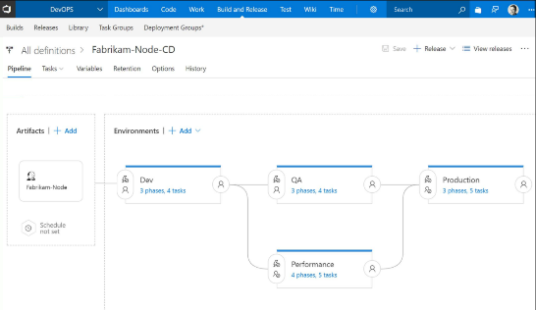
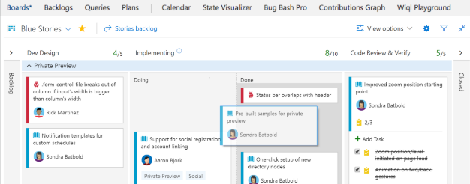
CI/CD Tools
Visual Studio Team Services
Microsoft’s Continuous Integration & Continuous Delivery Tool
Test and deploy your code to production with high-performance pipelines. Start small and scale up as needed.
VSTS has everything you love about Git with free private repositories, pull requests, and code review.
Collaborate with coworkers then integrate with CI/CD to get your code to production fast.
VSTS gives you configurable Kanban boards, interactive backlogs, simple planning tools, and out-of-the-box support for Scrum-all integrated together for traceability and reporting.
Code once and share packages across your organization. Host your private Nuget, npm, and Maven packages with VSTS for more reliable, scalable builds.
Use VSTS to setup test plans and track and report manual tests, run automated test suites, and run cloud-based load tests.

Slide 10
Azure Resource Manager Overview

Slide 11



Azure structure
Account and enterprise agreement
Subscription(s)
Resource group
Resource group
SQL
SQL
Role-based access control
Tags
Azure Resource Manager policy
Templates
Notes:
Presentation notes:
Key concepts:
Resource groups: application lifecycle boundary; container that holds resources.
Resources: web apps, Azure SQL Database, storage account, network, and so on…almost everything.
RBAC (role-based access control): User groups with role permissions assigned to resource groups.
Tags: Key value pairs assigned to resources or resource groups.
Policy: Restrictions on resources; for example, we can enforce mandatory tags per resource type.
Templates: JSON (JavaScript Object Notation) defining deployment and configuration of your application.
Slide objective:
Explain the hierarchy of the Azure model and key concepts.
Speaker notes:
When we talk about how we’ve done our Azure structure, we think about subscriptions. You want to lay out your subscriptions based on technology, the type of policy that you want to apply, and how your business is laid out. We use RBAC, which is role-based access control, to ensure that the right people have the right access to the right subscriptions. We want to make sure that people can operate their business, information remains protected, and people can’t make changes when they’re not supposed to.
The lower level is the concept of the resource group, an Azure construct that allows you to put the various resources associated with a single app into a resource group and then apply policy from Azure Resource Manager and tags. We use tags—key-value pairs—in Microsoft IT to identify the organization that it’s related to, the environment, and the app ID, a unique identifier. We can use these tags to associate different resources to a different app, organization, or environment, and then make business decisions based on that. Resources include web apps, Azure SQL Database, storage account, and so on.
Templates: We’ve created specific templates that internal teams can use to build out resources, and we ensure that they build them out according to our standards and policies. Templates enforce the creation of tags for tracking.

Slide 12
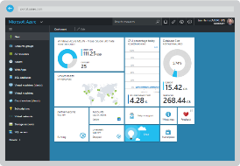
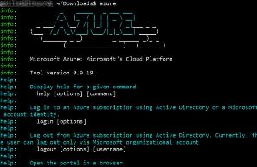
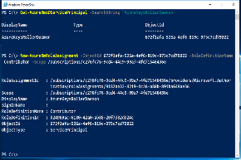

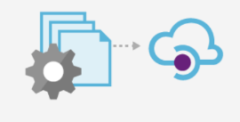
Azure Portal
Azure CLI
Azure PowerShell
Azure Resource Manager
Tenant
Tenant
Azure API
Subscription
Subscription
Subscription
Resource Group
Resource Group
Resource Group
Resource Group

Slide 13
Resource Providers
Web Site
Storage
Individual resources
Provision resources in isolation
Deployment becomes more complex
Management of app is challenging
Proper use of resources becomes more abstract
Isolation makes communication a challenge
Database
Virtual Machine

Slide 14
Resource Groups
Logical groups of multiple resources of similar or different types
Every resource must be in a resource group, cannot be in more than one
Resources inside resource group may span across regions
Resource Group has a location for storing metadata
RESOU
R
CE G
R
OUP

Slide 15
Creating a template
Visual Studio
Resource Group project type contains a UI to help add resources to a template
Intellisense helps you spot syntax errors and tips on schema definition
Visual Studio code
No IDE, but can be configured for ARM template usage through an extension
Quickstart templates
https://github.com/Azure/azure-quickstart-templates
Export Template from existing Resource Group
To duplicate or slightly modify an existing template

Slide 16
The template
Structure and elements
{
"$schema": "http://schema.management.azure.com/schemas/2015-01-01/deploymentTemplate.json#",
"contentVersion": "",
"parameters": { },
"variables": { },
"resources": [ ],
"outputs": { }
}
Declarative syntax
Allows you to declare the resources you want to have without having to write the script sequence of commands required to create it.

Slide 17
The template - Parameters

Slide 18
The template - Variables
"variables": {
"storageAccountName": "[concat(uniquestring(resourceGroup().id), 'sawinvm')]",
"nicName": "myVMNic",
"subnetRef": "[resourceId('Microsoft.Network/virtualNetworks/subnets', parameters('virtualNetworkName'), parameters('subnetName'))]",
"environmentSettings": {
"test": {
"instancesSize": "Small",
"instancesCount": 1
},
"prod": {
"instancesSize": "Large",
"instancesCount": 4
}
}
}

Slide 19
The template - Resources
{ "type": "Microsoft.Storage/storageAccounts",
"name": "[variables('storageAccountName')]",
"apiVersion": "2016-01-01",
"location": "[resourceGroup().location]",
"sku": {
"name": "Standard_LRS"
},
"kind": "BlobStorage",
"properties": { "accessTier": "Hot" }
},
{ "type": "Microsoft.Storage/storageAccounts",
"name": "[parameters('storageAccountName')]",
"apiVersion": "2015-06-15",
"location": "[resourceGroup().location]",
"properties": {
"accountType": "Standard_LRS"
}
}

Slide 20
Deploying the template
Powershell
New-AzureRmResourceGroupDeployment -Name ExampleDeployment -ResourceGroupName ExampleResourceGroup -TemplateFile <PathToTemplate> -
Azure CLI
azure group deployment create -f "c:\MyTemplates\example.json" -g examplegroup
-n exampledeployment
REST API
PUT /subscriptions/{subscriptionId}/resourcegroups/{resourceGroupName}/providers/Microsoft.Resources/deployments/{deploymentName}?api-version=2016-09-01
azure group deployment create -f "c:\MyTemplates\example.json" -g examplegroup
-n exampledeployment

Slide 21
Template Tools ( http://aka.ms/azuretools )
Visual Studio
Visual Studio Code
PowerShell / CLI
VSTS
https://docs.microsoft.com/en-us/azure/azure-resource-manager/resource-group-template-functions
https://docs.microsoft.com/en-us/azure/templates/

Slide 22
Challenge #1 Step 2: Create a “Hello World” template
Create a template that:
Takes one input parameter
Returns one output value
Deploy it from Azure CLI

Slide 23
Tour of Advanced Functions
Array and Objects
Concat()
Comparison
”Condition” field on a resource using equals()
Deployment
Linking
Numeric
copyIndex() used for looping
Resource
resourceGroup().location and .tags (array of tags)
String
toLower()
uniqueString(context), talks about context of uniqueness (resourceGroup, Subscription, etc)
https://docs.microsoft.com/en-us/azure/azure-resource-manager/resource-group-template-functions-array

Slide 24
ARM Advanced Feature: concat()

Slide 25
Concat()…array and object function
Combines multiple arrays and returns the concatenated array, or combines multiple string values and returns the concatenated string
Concatenating multiple strings to create unique and dynamic names (in my opinion) is the most common and useful
“variables”: {
“vnetName”: “[concat(parameters(‘prefix’),’-VNET’)]”
…
}
https://docs.microsoft.com/en-us/azure/azure-resource-manager/resource-group-template-functions-array#concat

Slide 26
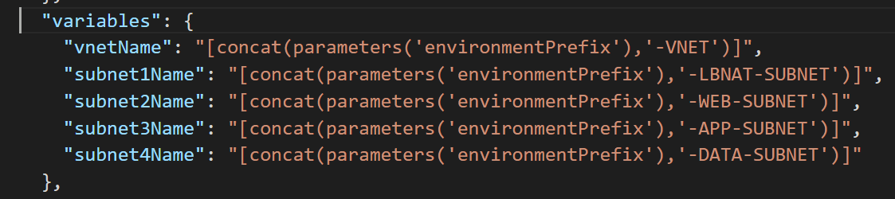
Snippet: concat() in action

Slide 27
ARM Advanced Feature: condition and equals()

Slide 28
Condition()…comparison functions
Allows you to compare two values with functions such as equals, less, lessOrEquals, greater, greaterOrEquals
Combine “equals” with the “condition” element to test whether a resource is deployed (most useful example of comparison functions that I’ve found yet)
{
“condition”: “[equals(variables(‘newOrExisting’),’new’]”
…
}
https://docs.microsoft.com/en-us/azure/azure-resource-manager/resource-group-template-functions-comparison

Slide 29
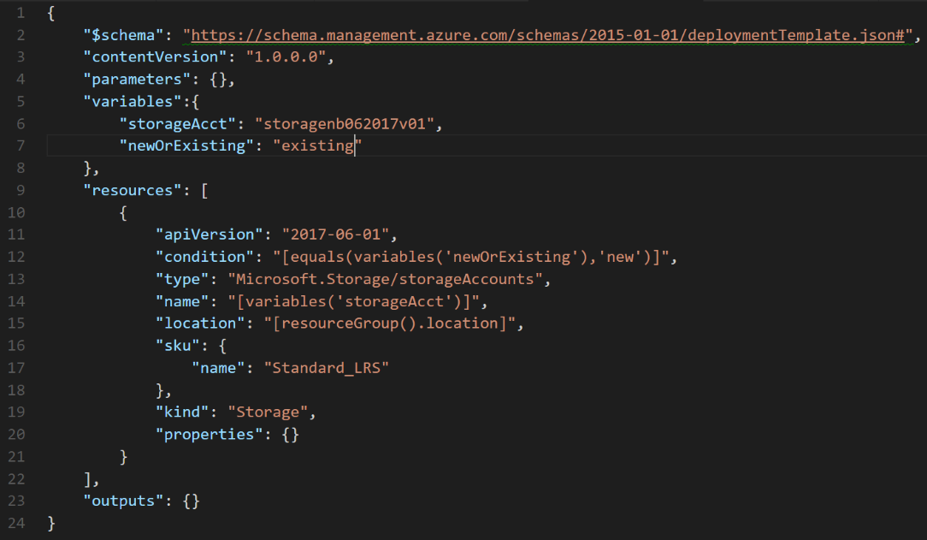

Slide 30
ARM Advanced Feature: copyIndex() aka Looping

Slide 31
copyIndex()…numeric function
Add a “copy” section to a resource and reference with the copyIndex() function
"resources": [
{
"apiVersion": "2016-01-01",
"type": "Microsoft.Storage/storageAccounts",
"name": "[concat(copyIndex(),'storage', uniqueString(resourceGroup().id))]",
"location": "[resourceGroup().location]",
"sku": {
"name": "Standard_LRS"
},
"kind": "Storage",
"properties": {},
"copy": {
"name": "storagecopy",
"count": 3
}
}
https://docs.microsoft.com/en-us/azure/azure-resource-manager/resource-group-create-multiple

Slide 32
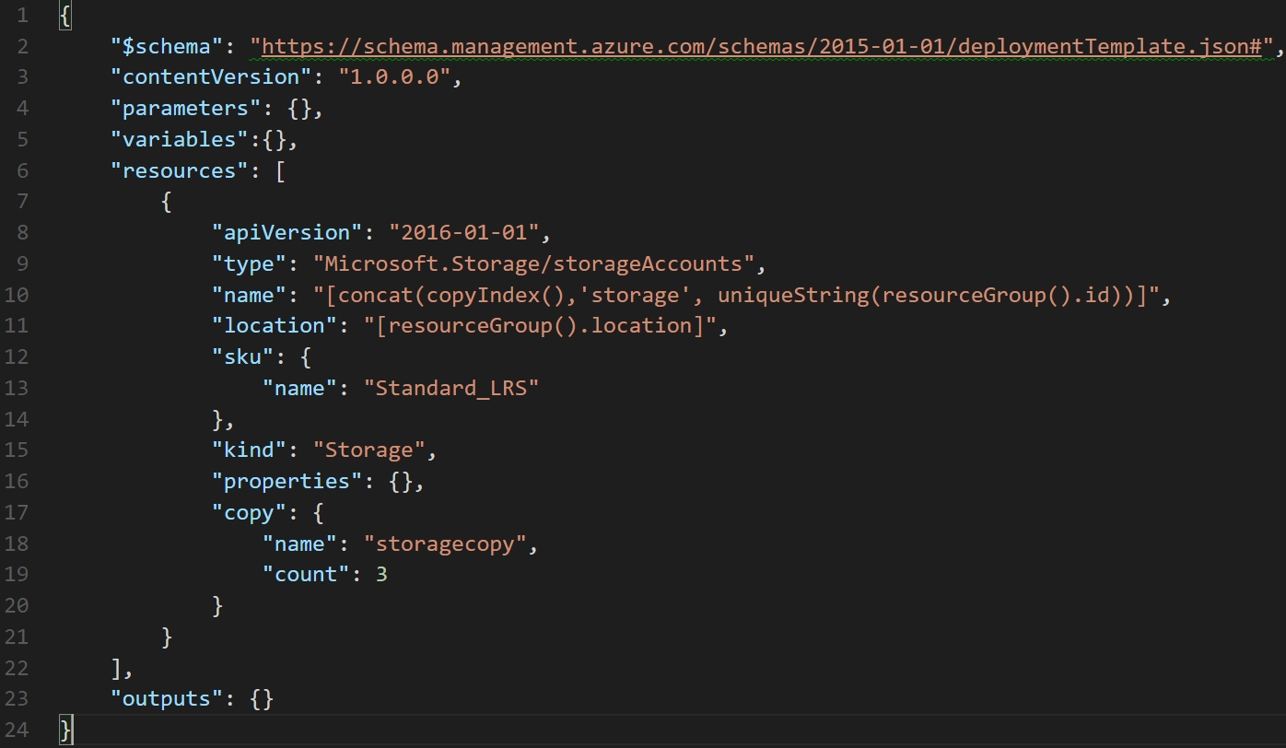

Slide 33
Hands-on: Create an ARM Template with Advanced Features

Slide 34
Challenge #2 Deploy a simple network stack
Extend template to provision VNET w/one subnet
Template takes the following inputs:
Virtual Network Name and Address Prefix
Subnet Name and Address Prefix
Find an easier way to pass in parameters

Slide 35
Practices to avoid. . . ( !best practices )
Starting from scratch. . .
Leverage QuickStarts, Automation Script / Export, etc. to quickly get started
Over-parameterization (no defaultValues)
Use variables, functions/expressions, & intelligent defaults!
Duplicating code
Copy/Pasting and Nesting instead of using copy loops & functions/expressions
Variables for the sake of variables
“vmName” : “[parameters(‘vmName’)]”
Secrets in source
Use KeyVault and Managed Identity
Variables for api-version
New api-version represents an updated payload
Using the wrong template expression, wrong function or wrong approach (mul)
E.g. use resourceId() instead of concat()
Not using a template expression or wrong function
Unnecessary dependencies
Use dependsOn and/or reference() only when necessary
Hard-coding
URIs, Ips, secrets, locations, VM sizes, etc
RunOnce behaviors
Build idempotent, re-entrant templates
Thinking imperatively
ARM templates describe the goal state of an application, and the sequence in which that state can be realized
https://github.com/Azure/azure-quickstart-templates
Notes:
NSG – Secure the app
User Choice – when it makes sense (location, SKU)
Use reference for endpoints

Slide 36
ARM Best Practices (it’s personal)
Naming Conventions
Parameter Usage
Variable Usage
Outputs
One-ring-to-rule-them-all (single giant template) vs Nested (aka linked) templates
Reference Link: https://docs.microsoft.com/en-us/azure/azure-resource-manager/resource-manager-template-best-practices

Slide 37
Challenge #3 Deploy more than one resource
Extend template to open ports 80 and 22 on the default subnet
Hint: Consider variables, dependencies, and idempotency

Slide 38
Challenge #4 Let’s do something real…
Extend template to deploy a webserver VM
VM Requirements:
Linux VM
Apache website
Pull website config from: https://raw.githubusercontent.com/albertwo1978/training-events/master/p20-arm/scripts/install_apache.sh
Hint: Custom script extensions, globally unique naming context, and complex dependencies! ☺

Slide 39
Challenge #5 Prepare to scale!
Add a public load balancer and put webserver in the backend pool
VM Requirements:
Create frontend pool enabling port 80 to website
Notes:
If we’re talking to customers about devops in the cloud, then these are sure to be hot topics you will want to be familiar with.
Key to managing complexity with open source solutions is automation.
Chef, Puppet, Ansible, Terraform… these are all things that help you treat infrastructure as code and make it easy to automate repeatable set up of cloud environments.
You should at minimal be familiar with the purpose of these tools.
If you have time to learn, be able to do a quick demo in any of these is useful too.
Containers are quite buzzworthy these days.
It’s relatively easy to learn about Docker and use the command line to set up and deploy some containers with common apps in them.
Also make a great demo!

Slide 40
Challenge #6 Network access policies
Extend template to add NAT rule to ILB for SSH access to backend
Notes:
VS Code is a great tool to share with folks using open source tools.
It started as a lightweight code-editor that is cross-platform (Mac, Linux, and Windows)
It’s still a lightweight code-editor (compared to Visual Studio!)… but it’s got a lot of nice hooks into Azure, Github, and other dev tooling.
And if you’re editing files on your Linux VM… you can use ‘rmate’ to open files “remotely from the VM” for editing on your local PC!
It makes a great demo.
And it’s easier than using vim or emacs. (← oh yes… you should also get familiar with those too!)

Slide 41
Challenge #7 Now let’s scale it!
Extend template to replace VM with a VM Scale Set
VMSS Requirements:
Linux VM
Convert NAT rule to NAT pool
Notes:
VS Code is a great tool to share with folks using open source tools.
It started as a lightweight code-editor that is cross-platform (Mac, Linux, and Windows)
It’s still a lightweight code-editor (compared to Visual Studio!)… but it’s got a lot of nice hooks into Azure, Github, and other dev tooling.
And if you’re editing files on your Linux VM… you can use ‘rmate’ to open files “remotely from the VM” for editing on your local PC!
It makes a great demo.
And it’s easier than using vim or emacs. (← oh yes… you should also get familiar with those too!)

Slide 42
Challenge #8 Install some software on those VMs!
Extend template to add a custom script extension that installs a web server package/role and deploy a basic web app
VMSS Requirements:
Pull website config from: https://raw.githubusercontent.com/albertwo1978/training-events/master/p20-arm/scripts/install_apache_vmss.sh
Notes:
VS Code is a great tool to share with folks using open source tools.
It started as a lightweight code-editor that is cross-platform (Mac, Linux, and Windows)
It’s still a lightweight code-editor (compared to Visual Studio!)… but it’s got a lot of nice hooks into Azure, Github, and other dev tooling.
And if you’re editing files on your Linux VM… you can use ‘rmate’ to open files “remotely from the VM” for editing on your local PC!
It makes a great demo.
And it’s easier than using vim or emacs. (← oh yes… you should also get familiar with those too!)

Slide 43
Challenge #9 Let’s scale it automatically
Extend template to include auto scaling policy to scale when CPU performance hits 90%
VMSS Requirements:
Scale back down when CPU hits 30%
Scale in single VM increments
Enforce a 1 minute cool down between scale events
Notes:
VS Code is a great tool to share with folks using open source tools.
It started as a lightweight code-editor that is cross-platform (Mac, Linux, and Windows)
It’s still a lightweight code-editor (compared to Visual Studio!)… but it’s got a lot of nice hooks into Azure, Github, and other dev tooling.
And if you’re editing files on your Linux VM… you can use ‘rmate’ to open files “remotely from the VM” for editing on your local PC!
It makes a great demo.
And it’s easier than using vim or emacs. (← oh yes… you should also get familiar with those too!)

Slide 44
Challenge #10 Break it down into smaller parts
Separate deployments into nested templates
Minimum Requirements:
Separate virtual network and VMSS into two linked templates
Hint: Use blob storage + SAS token to load linked templates ☺
Notes:
VS Code is a great tool to share with folks using open source tools.
It started as a lightweight code-editor that is cross-platform (Mac, Linux, and Windows)
It’s still a lightweight code-editor (compared to Visual Studio!)… but it’s got a lot of nice hooks into Azure, Github, and other dev tooling.
And if you’re editing files on your Linux VM… you can use ‘rmate’ to open files “remotely from the VM” for editing on your local PC!
It makes a great demo.
And it’s easier than using vim or emacs. (← oh yes… you should also get familiar with those too!)

Slide 45
Challenge #11: (Day 3):
Bonus:
Deploy Jenkins and/or VSTS for CI/CD
Piece together previously created content into pipeline
Parameterize VM names in Jenkins

Slide 46


